Slide 1
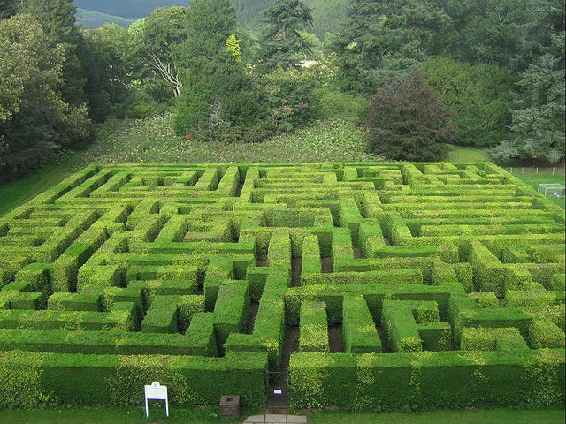
Maze Solver Game
Project Title: Maze Solver Game
Course Name: CSE 115
Section: 2
Instructors Name: Mohammad Shifat-E-Rabbi
Group Members:
- Member 1: Arnob Mallik Dhruba
ID: 2512446642
- Member 2: Sumaya Islam Kotha
ID: 2511242642
- Member 3: Samrin Fatema
ID: 2513373042
- Member 4: S.M. Robiul Islam
ID: 2513924642

Slide 2
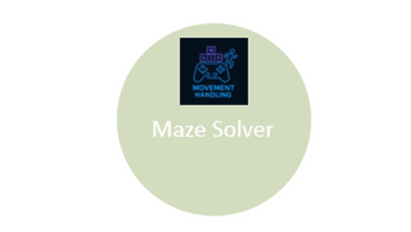
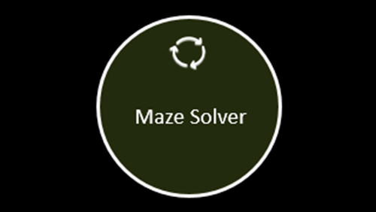
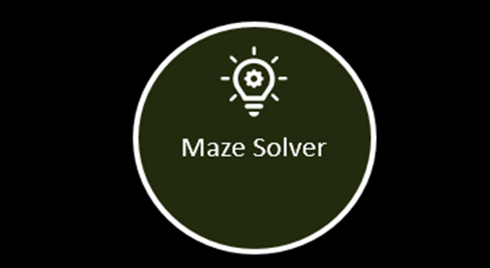
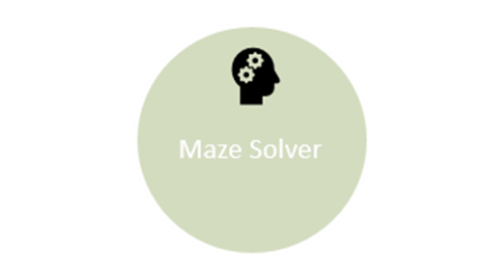
Group No. 5

Slide 3
Maze Solver

Slide 4
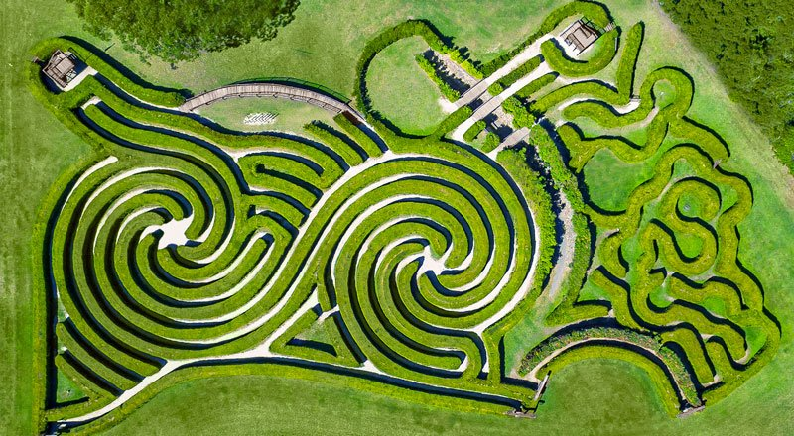
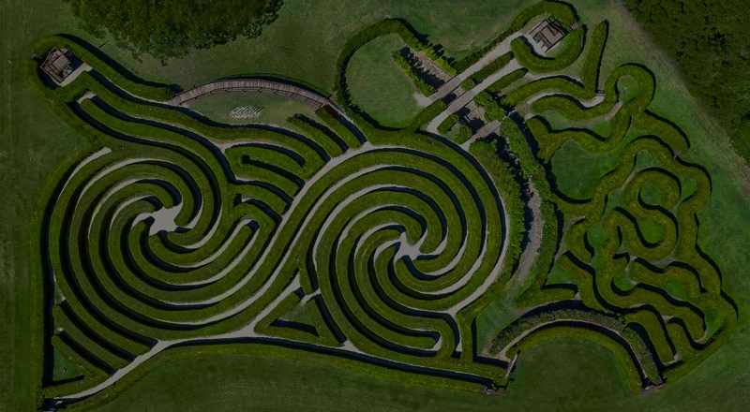

Introduction
• What is a Maze Solver Game?
• Objective: Navigate a player from start to end of a maze
• Implemented using C with basic concepts only
Group No. 5
Arnob Mallik Dhruba

Slide 5
Motivation
• Enhances logic and problem-solving
• Combines creativity with C programming
• Great exercise in working with terminal games
Project Objectives
• Build an interactive maze game
• Use simple C features: structures, arrays, loops
• Player control using keyboard
• Track number of steps
Group No. 5
Arnob Mallik Dhruba

Slide 6
Tools and Technologies
• Language: C
• Compiler: GCC / Turbo C / Code::Blocks
• Platform: Windows (conio.h, windows.h)
• IDE: Optional (VS Code, Code::Blocks)
Group No. 5
Arnob Mallik Dhruba

Slide 7
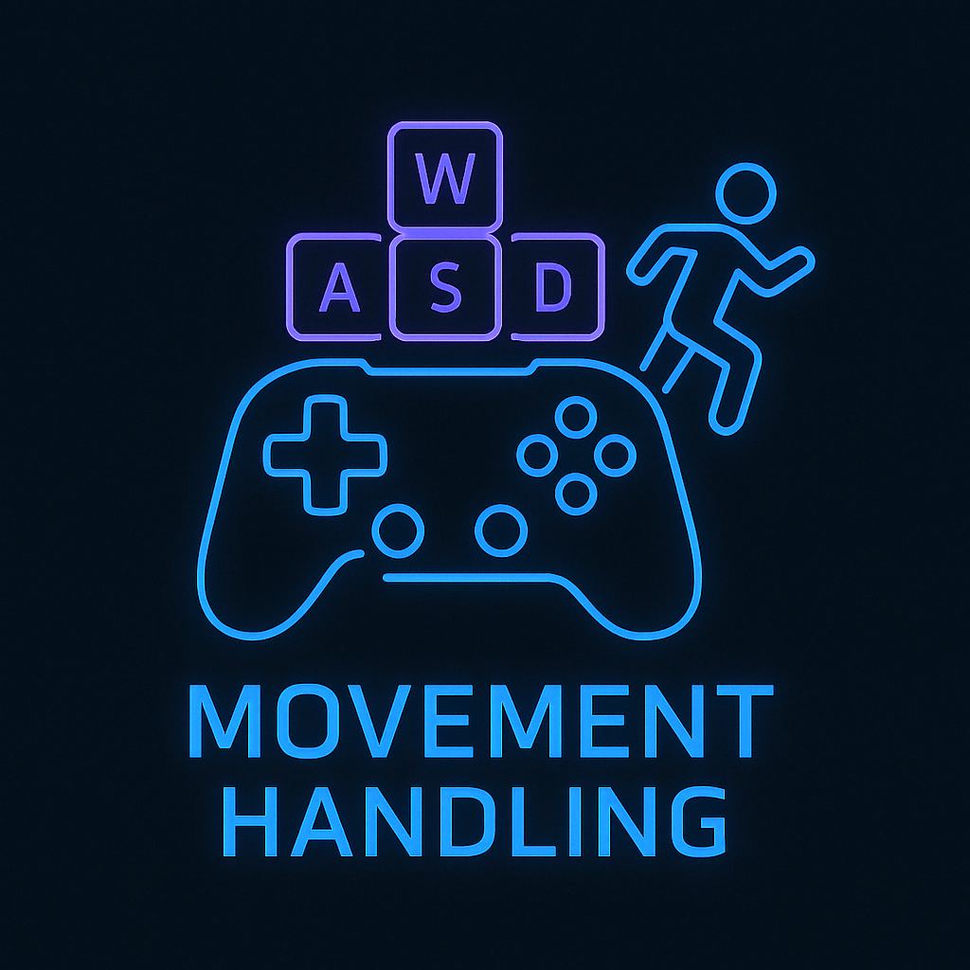
Maze Solver

Slide 8


Basic Game Design
• 20x10 grid
• Start: Top-left (P)
• End: Bottom-right (E)
• Movement: W/A/S/D
• Obstacles: #, Path: ' '
Group No. 5
Sumaya Islam Kotha

Slide 9
Code Overview – Main Function
• Initializes game
• Loops with replay option
• Seeds RNG
• Calls all major game functions
Code Overview – Structures
struct Player { int x, y, steps; };
struct Maze { char grid[HEIGHT][WIDTH]; };
• Player position & steps
• Maze grid
Group No. 5
Sumaya Islam Kotha

Slide 10
Maze Generation
• Fills maze with walls (#)
• Generates simple random path to end
• Start = (0,0), End = (19,9)
Display Function
• Clears screen
• Prints maze
• Shows player as P
• Displays step count and controls
Group No. 5
Sumaya Islam Kotha

Slide 11
Maze Solver

Slide 12
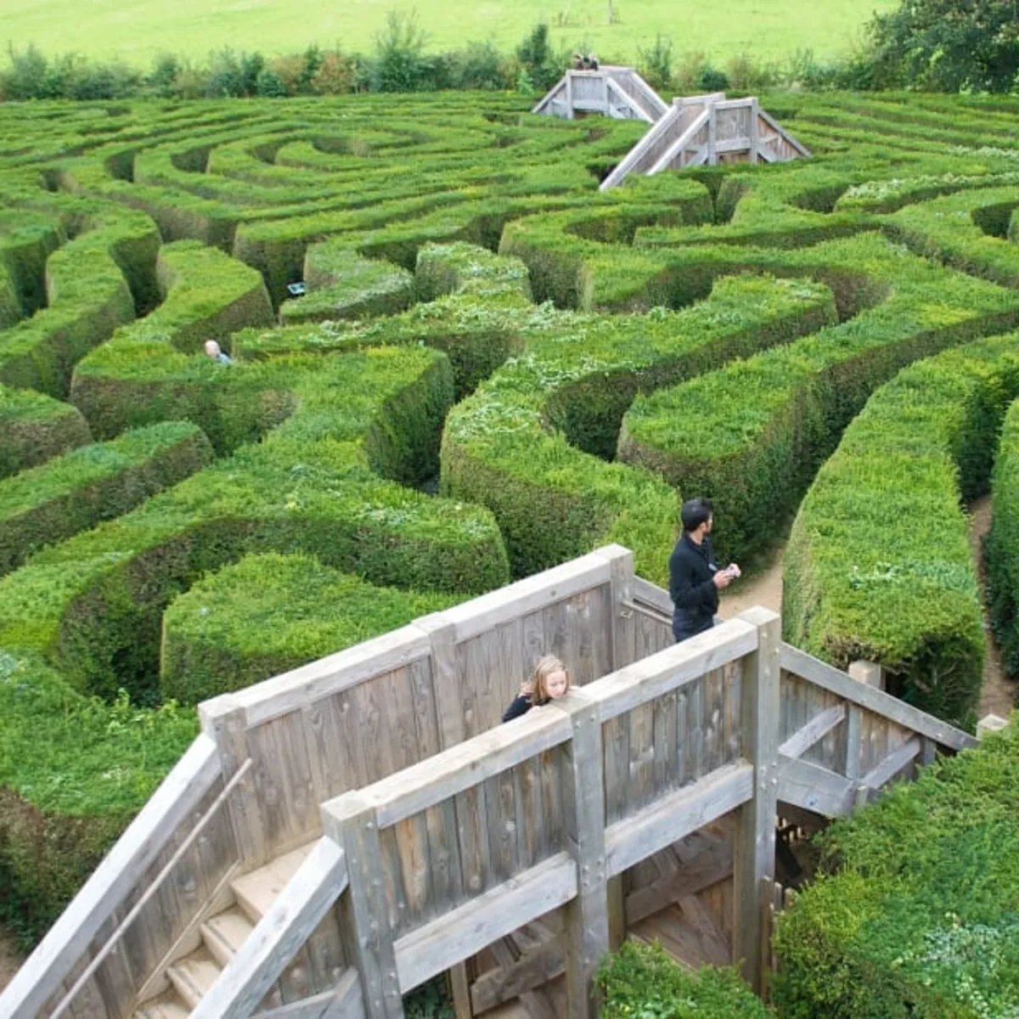
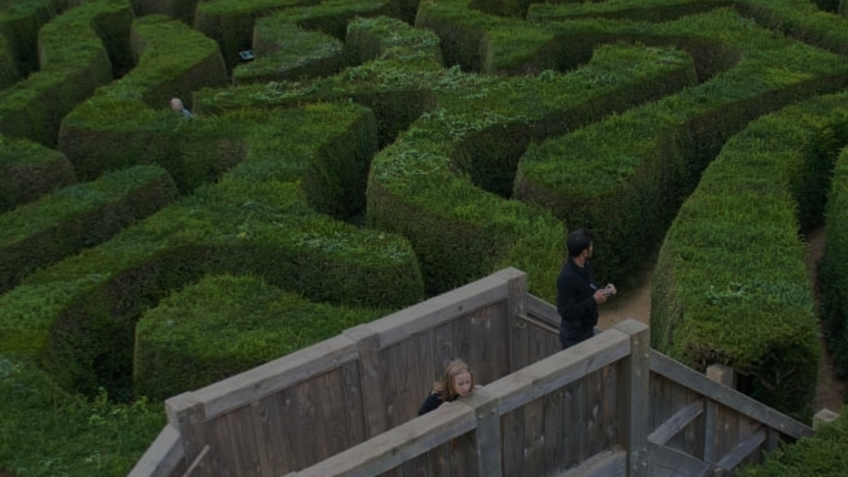
Movement Logic
• Input: W, A, S, D
• Checks bounds and walls
• Updates position if valid
• Increments steps
Game Loop
• Runs until player reaches end or quits
• Processes user input
• Prints messages based on outcome
Group No. 5
Samrin Fatema

Slide 13
Features
• Keyboard controls
• Real-time movement
• Step counter
• Simple random maze path
• Replay support
Group No. 5
Samrin Fatema

Slide 14
Limitations
• Only one path
• No complex maze generation
• No traps or enemies
• Windows-only (conio.h, windows.h)
Group No. 5
Samrin Fatema

Slide 15
Maze Solver

Slide 16
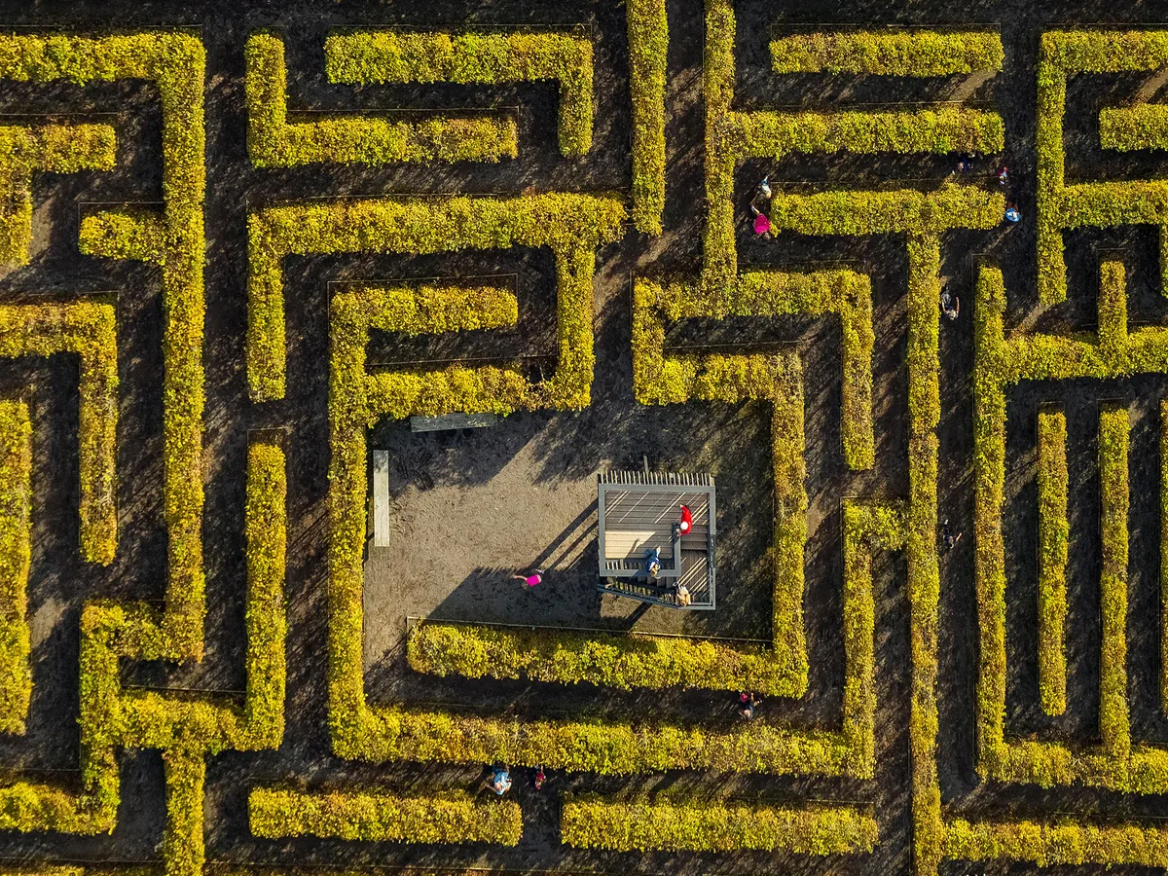
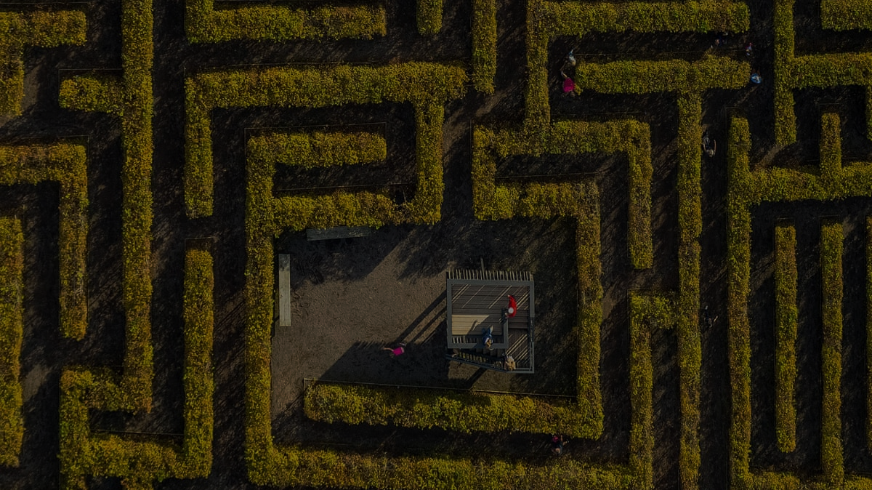
Learning Outcomes
• Function and structure usage
• Real-time input handling
• Terminal game design
• Logic and movement control
Group No. 5
S.M. Robiul Islam

Slide 17
Challenges Faced
• Designing random path logic
• Handling invalid moves
• Replay functionality
• Output formatting
Group No. 5
S.M. Robiul Islam

Slide 18
Possible Enhancements
• Complex maze generator
• Timer mode
• Score saving
• Multiple difficulty levels
• Cross-platform compatibility
Group No. 5
S.M. Robiul Islam

Slide 19
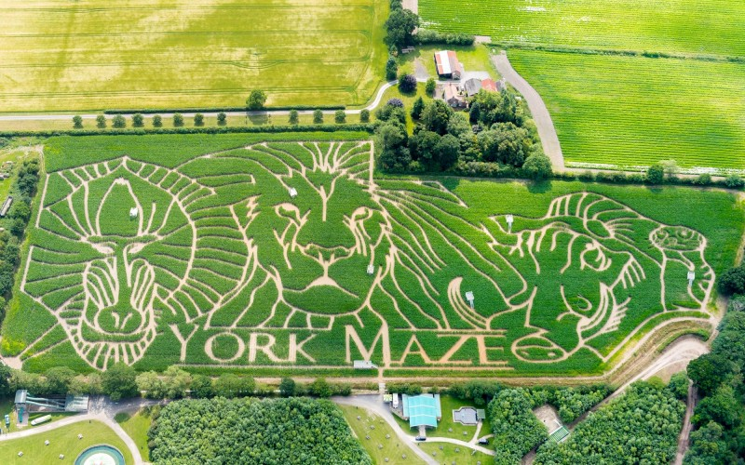

CONCLUSION
• Project Summary
• Learning Recap
Group No. 5

